Slide 1
Singapore Airlines AppChallenge 2023
https://github.com/ong-zijian/SIAAppChallenge

Slide 2


Team Introduction
Ong Zi Jian
SMU BSc Information Systems | Penultimate Student
Skills:
React.js, Vue.js, Flask, Node.js, Python, Java, MySql, Firebase, MongoDB
Description:
I am an aspiring developer/engineer aiming to work in the web, cloud, AI or ML fields. I am constantly learning new things, building new projects and expanding my repertoire of skills to be a better programmer.
Links:
Website, LinkedIn
Toh Richard
SMU BSc Information Systems | Penultimate Student
Skills:
Vue.js, Flask, Python, MySql
Description:
I am currently exploring a variety of fields in computing, including machine learning and cloud computing. I always strive to improve and build on what I have learnt in rapidly advancing and new technologies.
Links:
LinkedIn
Joshua Tan
SMU BSc Information Systems | Penultimate Student
Skills:
Vue.js, Python, MySql
Description:
I love to learn new things and have a budding interest in analytics. As I progress in the field, I hope to hone my data analysis skills and be able to draw impactful insights from data.
Links:
LinkedIn

Slide 3
Problem Statement
Challenge Category: Others
The demand for air travel has steadily returned to pre-covid levels as the pandemic subsides. However, customer sentiments of SIA have not been positive, citing complaints such as food quality and service among others.
In the age of digital technology, customers have a greater ability to choose between other first-rate airlines that rival SIA’s offered services such as Qatar Airways and Emirates, which are gaining popularity for their high quality of service.
We propose conducting sentiment analysis on Twitter posts, using AI tools to generate insights into areas of improvement for SIA to provide an unrivalled customer experience.

Slide 4
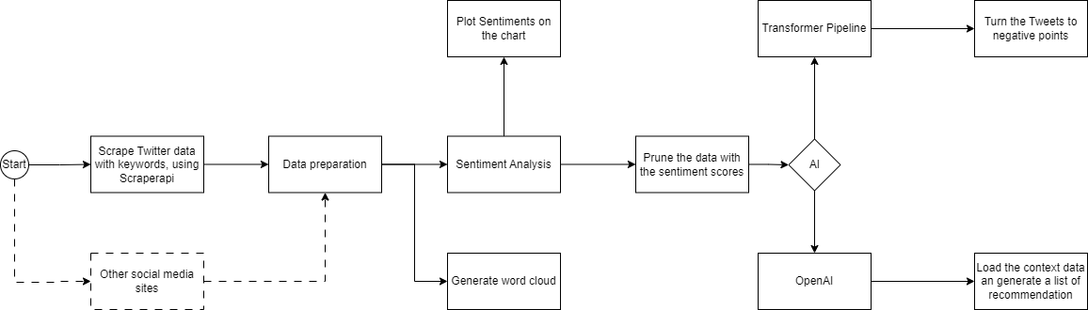
Solution
1. Scrape Twitter Data
We use ScraperAPI to scrape Twitter for Tweets to get data users have generated regarding SIA.
2. Data Preparation
We use simple Regex to clean the data and ensure that they can be tokenised or more easily processed. Although some models have auto tokenisers and basic data pre-processing, preliminary data preparation is a good practice to ensure that the model is not too resource intensive when data size increases.
3. Sentiment Analysis
We use textBlob to run the sentiment analysis. The tool will look at each tweet and give it a rating between -1 and 1, where -1 represents highly negative sentiments while 1 represents highly positive sentiments. With these labels, we can prune our data to obtain a relevant and workable dataset.

Slide 5
Solution (Cont.)
4. Prune the data
We determined that there were many official SIA tweets and tweets praising SIA within the dataset. These are not useful for generating insights for areas of improvement. From the generated sentiment scores, we remove data with scores above -0.1 (0.1 error from neutral). This will refine the dataset, keeping only complaint tweets, from which we can draw insight on how to improve customer experience.
5. QA Model
We use a QA model to look at the suggestions for improvement based on the input given.
6. OpenAI
The QA models have limitations and are less powerful than openAI models. The main challenge is in creating a summarised list of solutions. We want a smaller number of openAI-proposed solutions compared to the input, as much of the input sentiments can be generalised or categorised, leading to a more streamlined output with minimal bloat.
Rationale
From our code, one can observe that positive and neutral sentiments were pruned. Negative sentiments represent areas of improvement, where customer satisfaction can potentially grow the most.
Considering the scale of the data when we broaden the pipeline, it would be computationally costly to run even bigger datasets through the AI. Hence, this currently functions better as a Gap Analysis tool.
We also aim to present our data differently from traditional data analytics reports with large amounts of statistics and charts. We focus here on developing a high-level report for executives to read, using the suggestions to make a business decision.

Slide 6




Tech Stack
ScraperAPI
ScraperAPI is a popular web scraper for data acquisition that gets around pages which are blocked or behind protection, notably big social giants (e.g. Twitter) by using proxies at cheap rates while providing utility with different languages such as Python and Java.
TextBlob
Textblob is a Python Library for NLP which offers some pre-processing functionality such as spelling correction and sentiment analysis based on its pre-trained and built-in classifier and a variety of use cases such as tokenization.
OpenAI
OpenAI API can identify common or recurring text in the data input to find issues relevant to SIA based on prompts given and provide a list/ranking of problems and negative reviews.
HuggingFace
HuggingFace Question Answering NLU Model has the benefit of being available in AWS Sagemaker to build a custom dataset to suggest specific and relevant improvements. This can be scaled and tailored according to needs or issues found.
Notes:
https://www.capterra.com/p/238595/Scraper-API/reviews/
https://towardsdatascience.com/my-absolute-go-to-for-sentiment-analysis-textblob-3ac3a11d524
https://aws.amazon.com/blogs/machine-learning/build-a-custom-qa-dataset-using-amazon-sagemaker-ground-truth-to-train-a-hugging-face-qa-nlu-model/
https://www.datacamp.com/tutorial/an-introduction-to-using-transformers-and-hugging-face
https://www.topcoder.com/thrive/articles/getting-started-with-textblob-for-sentiment-analysis

Slide 7
Justification & Value Proposition
(+) Up-to-date data and sentiments
With a data scraper operating automatically on pre-assigned intervals, our solution can generate current and relevant actionable improvements on demand.
(+) Providing a transparent and straightforward report
Our solution gives a clear look into how and where sentiment analysis takes place, allowing accurate pinpointing of urgent issues and how to resolve them.
(+) Scalability
Our solution can be continuously customised for better accuracy based on advances in NLP, which can be further developed to include different languages, increasing coverage on customers’ reviews in their native language - a huge boon as SIA services flights to many countries with just as many languages.

Slide 8
Justification & Value Proposition (Cont.)
(+) Social Media Analytics and Data
With the advent of social media, customers can make both their complaints and suggestions for improvement easily heard by a wide audience on digital platforms. User posts on social media can influence public opinion and behaviour, including consumption patterns (Mostafa, 2013). The data obtained from such channels could be useful for SIA to improve service quality and brand image. Sentiment Analysis integrated with AI-powered technology and Cloud computing can reduce costs associated with traditional data processing.
(+) How Sentiment Analysis can help
By providing a solution utilising sentiment analysis that generates a single view (report), SIA can gain insight into the specific issues affecting service quality and provide a clear justification to executives to direct necessary efforts to the right areas. A prior study on Twitter data regarding Airline reviews has proven the advantages of utilizing sentiment analysis to gain customer insights and their associations with underlying causes, which is recommended to improve customer experience (Kumar, S., Zymbler, M., 2019).
Notes:
https://www.indeed.com/career-advice/career-development/what-is-social-media-analytics
https://customerthink.com/how-ai-powered-customer-sentiment-analysis-software-enhances-brand-cx/

Slide 9
Go-To-Market (GTM)
To successfully GTM, we need to automate some processes and turn them into enterprise-level resources.
1. Using an Enterprise Solution
ScraperAPI is limited on what it can achieve using the free version. We suggest using the premium category or another API software that can handle big data and data scraping at scale.
AI models also need to be upgraded to handle such scale. We suggest an organisation-level subscription to OpenAI. If there are AI engineers available, SIA could build its own model and host it within in-house servers or cloud.
2. Improving Pipelines
We only scraped Twitter data as a demonstration. Customer complaints or posts can come from a variety of streams. This may include Reddit, Facebook, Instagram or even LinkedIn. Certain social media sites may contain bias due to user demographics and lifestyles. Data should be sourced from different platforms to create a holistic solution.
3. Automate a create a full Flow
The last major step is to automate. Code could be hosted on AWS EC2 or on a SageMaker pipeline for AI/ML workloads. With this in place, data scraping can be scheduled to automatically execute every few days or weeks, to train the model and generate reports automatically.
4. Big Data
The quality of the sentiment analysis is reflective of the real customer concerns when there are sufficiently large datasets to work with (Mostafa, 2013). Therefore, as our pipelines improve, the data ingested can be scaled up to improve the future sentiment analyses.

Slide 10
References
Kumar, S., Zymbler, M. A machine learning approach to analyze customer satisfaction from airline tweets. J Big Data 6, 62 (2019). https://doi.org/10.1186/s40537-019-0224-1
Mostafa, M.M., 2013. An emotional polarity analysis of consumers’ airline service tweets. Social Network Analysis and Mining 3 (3), 635–649. https://doi.org/10.1007/s13278-013-0111-2.
OpenAI API. (n.d.). https://platform.openai.com/docs/api-reference/making-requests
Pipelines. (n.d.). https://huggingface.co/docs/transformers/main_classes/pipelines
Tutorial: Quickstart — TextBlob 0.16.0 documentation. (n.d.). https://textblob.readthedocs.io/en/dev/quickstart.html
GitHub Link: https://github.com/ong-zijian/SIAAppChallenge

Slide 11
Thanks!

